Slide 1
Using Data Assimilation to Calibrate High-Dimensional Hydrologic Parameters

Slide 2
Uncertainty in Models & Data
Data Assimilation Yucaipa Integrated Hydrologic Model
Use of Ensemble Smoother in Calibration
Model Fit Estimated Parameters
Outline
Uncertainty in model predictions and data,
Motivation for using data assimilations,
Basic idea of data assimilation,
Data assimilation methods,
Case Study: Calibration of Yucaipa Integrated Model Using Ensemble Smoother.

Slide 3
Uncertainty in Models & Data
Data Assimilation Yucaipa Integrated Hydrologic Model
Use of Ensemble Smoother in Calibration
Model Fit Estimated Parameters
Introduction – Uncertainty in Models and Data
Truth
Human-induced Noises
Conceptual Uncertainty
Data
Model
Instrument Bias
Algorithmic Uncertainty
Environmental Factors
Structural Uncertainty
Scattered data
Parametric Uncertainty

Slide 4
Uncertainty in Models & Data
Data Assimilation Yucaipa Integrated Hydrologic Model
Use of Ensemble Smoother in Calibration
Model Fit Estimated Parameters
Introduction – Cope with Uncertainty
Model Uncertainty
Uncertainty Reduction
Uncertainty Quantification
Conditioning model prediction to observed data and prior knowledge. Calibration is an uncertainty reduction tool.
How certain are your predictions? Predictions should be associated with confidence interval.
Data Assimilation

Slide 5
Uncertainty in Models & Data
Data Assimilation Yucaipa Integrated Hydrologic Model
Use of Ensemble Smoother in Calibration
Model Fit Estimated Parameters
Introduction – Forward vs. Inverse Modeling
Forward Modeling
Static Parameters
Model
System Forcing
Dynamic States
Inverse Modeling

Slide 6
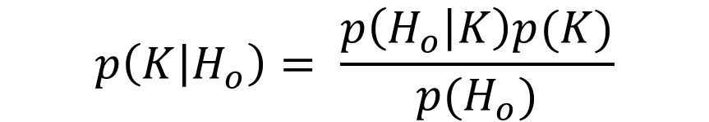

Uncertainty in Models & Data
Data Assimilation Yucaipa Integrated Hydrologic Model
Use of Ensemble Smoother in Calibration
Model Fit Estimated Parameters
Bayes’ Law
$$p\left(Parameters \right|Observations)= \frac{p\left(Observations | Parameters\right). p(Prior Parameter)}{p(Observations)}$$
$$H=G\left(K\right)$$
An abstract model that computes model response vector (H) from a vector of unknown input parameters (K). G is the model function.
When model response (H) is partially known, knowledge about unknown input parameters can quantified using Bayes Law
$$p\left(K | H_{o}\right)= \frac{p\left(H_{o} | K\right)p(K)}{p(H_{o})}$$
For Linear models and Gaussian input parameters there is an exact solution that is widely known as Kalman Filter.

Slide 7
Uncertainty in Models & Data
Data Assimilation Yucaipa Integrated Hydrologic Model
Use of Ensemble Smoother in Calibration
Model Fit Estimated Parameters
Ensemble-based Data Assimilation – (Evenson, 1994)
Prior Ensemble
Posterior Ensemble
Input 1
Model
Output 1
Input 2
Model
Output 2
Input 1’
Model
Output 1’
.
.
.
Input 2’
Model
Output 2’
.
.
.
Data Assimilation
Model
Input 500
Output 500
Model
Meas. 1
Input 500’
Output 500’
Meas. 2
Measurements
.
.
.
Meas. 500

Slide 8
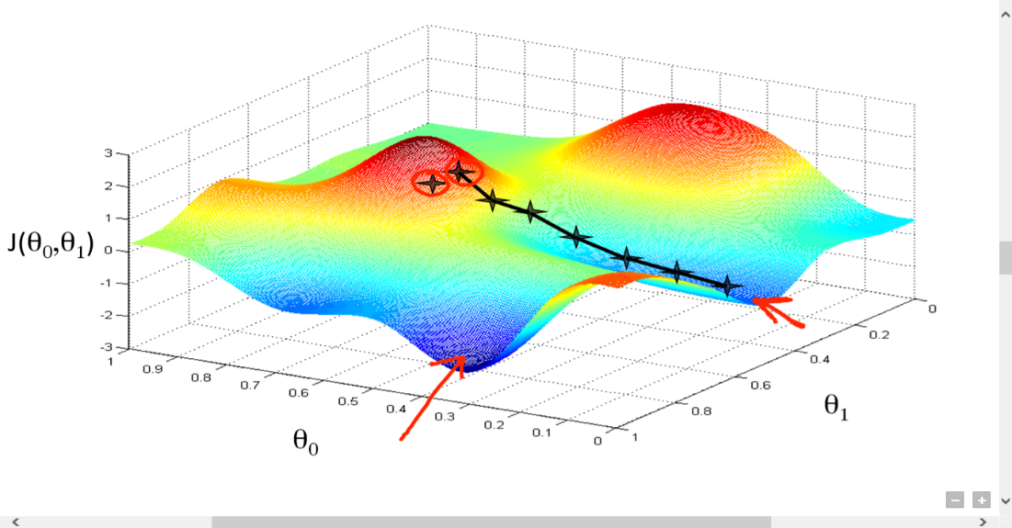
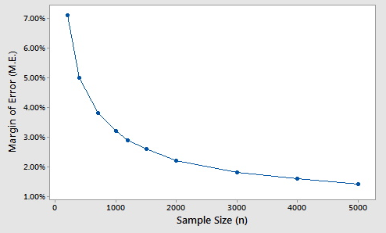
Uncertainty in Models & Data
Data Assimilation Yucaipa Integrated Hydrologic Model
Use of Ensemble Smoother in Calibration
Model Fit Estimated Parameters
Comparison with other methods
Gradient-Based Methods
Gradient-based methods (Like Levenberg Marquardt method in PEST) are sensitive to the initial parameter values.
Gradient-based methods require at least as many runs as the number of unknown parameters.
UQ can be done as a separate step.
Data Assimilation Methods
An ensemble of initial parameter values (Prior Ensemble) are used.
Forward runs (Sample size) is much smaller (m~10²) than number of estimated parameters (n~10⁶).
Uncertainty Quantification (UQ) is built in the data assimilation.
Source :https://hackernoon.com/gradient-descent-aynk-7cbe95a778da
O(1/N)

Slide 9
Uncertainty in Models & Data
Data Assimilation Yucaipa Integrated Hydrologic Model
Use of Ensemble Smoother in Calibration
Model Fit Estimated Parameters
More than calibration …
Static Parameters
Model
Prediction
System Forcing
Dynamic States
forecast
Update
Update
Data Assimilation
Measurements

Slide 10
Uncertainty in Models & Data
Data Assimilation Yucaipa Integrated Hydrologic Model
Use of Ensemble Smoother in Calibration
Model Fit Estimated Parameters
Data Assimilation methods
Ensemble Smoother
Past
Future
Ensemble Kalman Smoother
Ensemble Kalman Filter
Past
Future

Slide 11
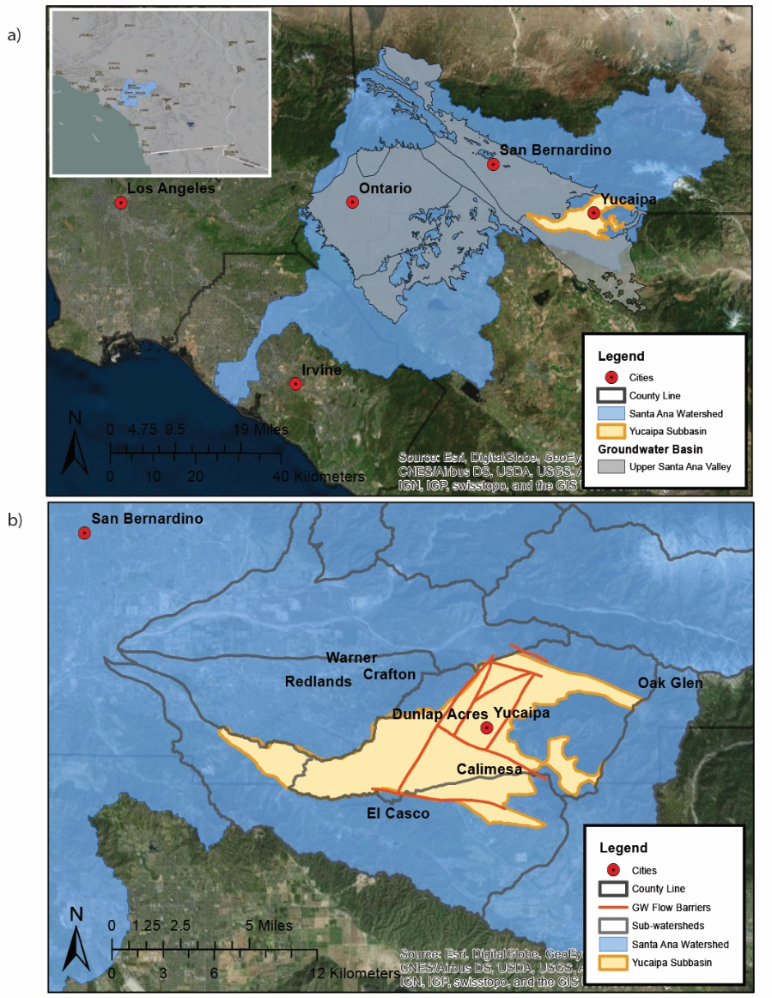
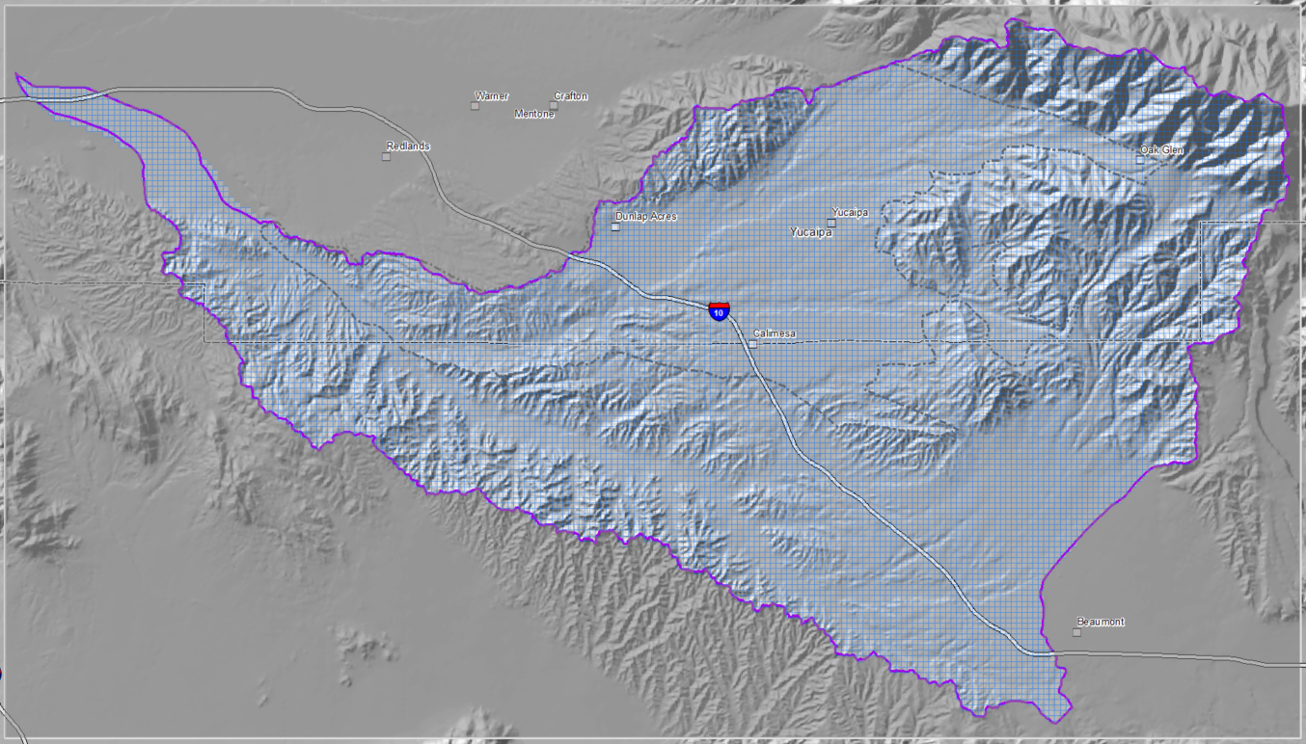
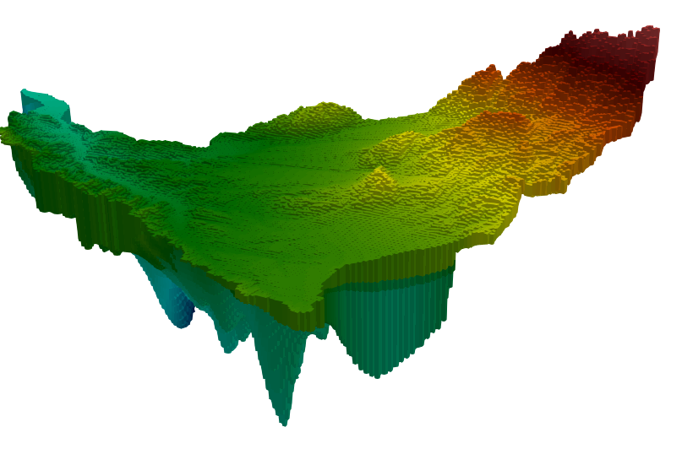
Uncertainty in Models & Data
Data Assimilation Yucaipa Integrated Hydrologic Model
Use of Ensemble Smoother in Calibration
Model Fit Estimated Parameters
Calibration of Yucaipa Integrated Hydrologic Model
21.8 miles
Inactive Domain
12.17 miles
Active Domain
Inactive Domain

Slide 12
Uncertainty in Models & Data
Data Assimilation Yucaipa Integrated Hydrologic Model
Use of Ensemble Smoother in Calibration
Model Fit Estimated Parameters
Calibration of Yucaipa Integrated Hydrologic Model
Groundwater Model Calibration
Integrated Model Calibration
Watershed Model Calibration
Stage (1)
MODFLOW
PRMS
Stage (2)
Stage (2)
GSFLOW

Slide 13
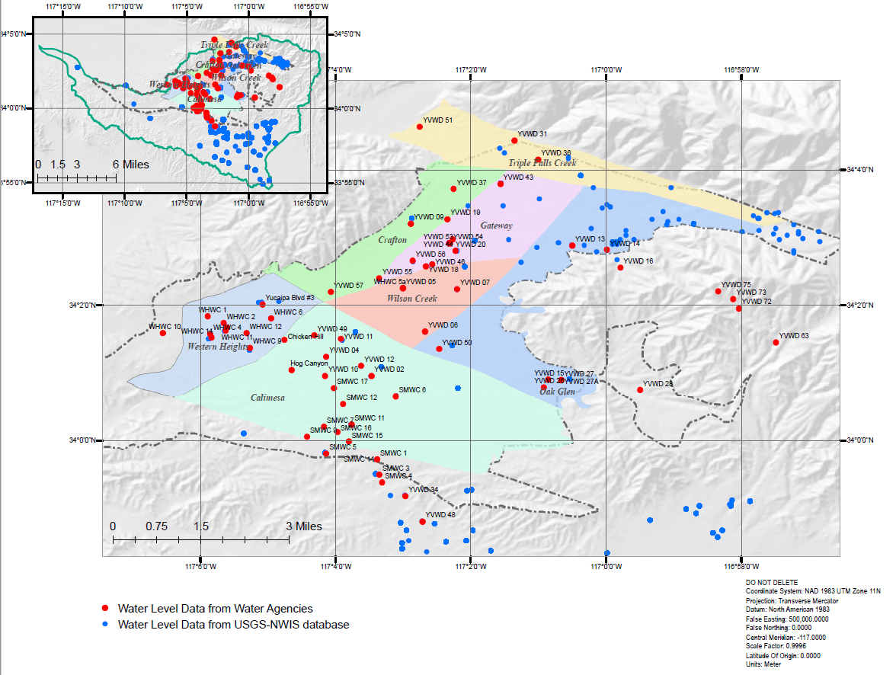
Uncertainty in Models & Data
Data Assimilation Yucaipa Integrated Hydrologic Model
Use of Ensemble Smoother in Calibration
Model Fit Estimated Parameters
Data & Estimated Parameters
Calibration Stage | Group | Description | Model Calibrated
Stages (I) and (II) | A | Parameters controlling hydraulic conductivity field which includes clay, sand, and course texture conductivities. | Steady State MODFLOW and GSFLOW
 | B | Parameters controlling boundary conditions. This group consists of 8 values for heads at both ends of the boundary condition. | Steady State MODFLOW and GSFLOW
 | C | Parameters controlling the conductance of 10 faults and barriers. | Steady State MODFLOW and GSFLOW
 | D | Parameters controlling Streambed hydraulic conductivities, which include 11 groups of segments. | Steady State MODFLOW and GSFLOW
 | E | Parameters controlling the unsaturated zone flow, which includes infiltration rate, 20 zonal values for vertical hydraulic conductivities, and parameters used to compute evapotranspiration rate and surface seepage rate. | Steady State MODFLOW and GSFLOW¹
 | F | Parameters controlling the simulation of solar radiation and potential evapotranspiration. | PRMS Only
Stage (II) only | G | Parameters specifying storage capacity of the saturated zone that include specific yield and specific storage fields | GSFLOW only
 | H | Parameters controlling natural recharge and anthropogenic recharge. This group consists of scaling factors for the spatially variable parameters. | GSFLOW only

Slide 14
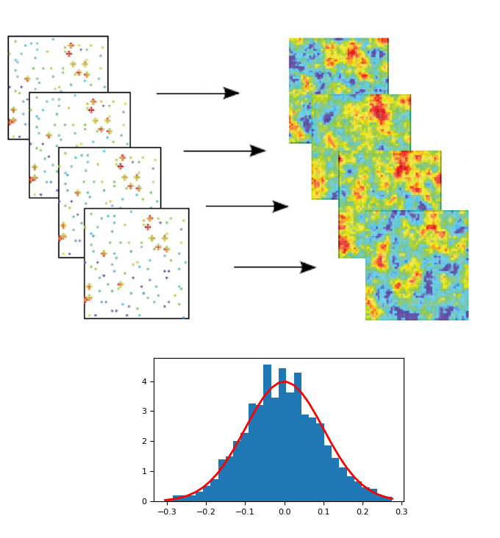
Uncertainty in Models & Data
Data Assimilation Yucaipa Integrated Hydrologic Model
Use of Ensemble Smoother in Calibration
Model Fit Estimated Parameters
Use of Ensemble Smoother
Spatially Varying Parameters
Simulation Output
GSFLOW
Scalar Parameters

Slide 15
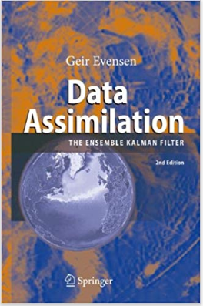
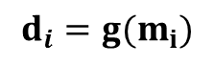
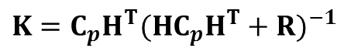
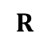
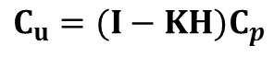
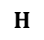
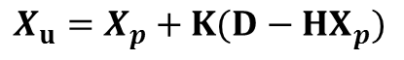
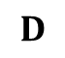
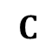
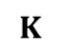
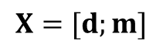
Uncertainty in Models & Data
Data Assimilation Yucaipa Integrated Hydrologic Model
Use of Ensemble Smoother in Calibration
Model Fit Estimated Parameters
Ensemble Smoother Implementation
Two-stage Procedure
Model forecast
PDF of Parameters is approximated using an ensemble of realizations
PDF of Predictions is approximated through Monte Carlo simulations
Model Update
Posterior PDFs are Gaussians with mean and covariance obtained using the following equations:
Where:
$$X=[d;m]$$
$$X_{u}=X_{p}+K(D−HX_{p})$$
$$C$$
: Ensemble Covariance Matrix
$$C_{u}=(I−KH)C_{p}$$
$$D$$
: Perturbed measurements
$$K=C_{p}H^{T}{({HC}_{p}H^{T}+R)}^{−1}$$
$$K$$
: Kalman Gain
$$H$$
: Binary matrix that extracts model
predictions at measurement
locations.
$$R$$
: Covariance matrix of measurements
errors

Slide 16
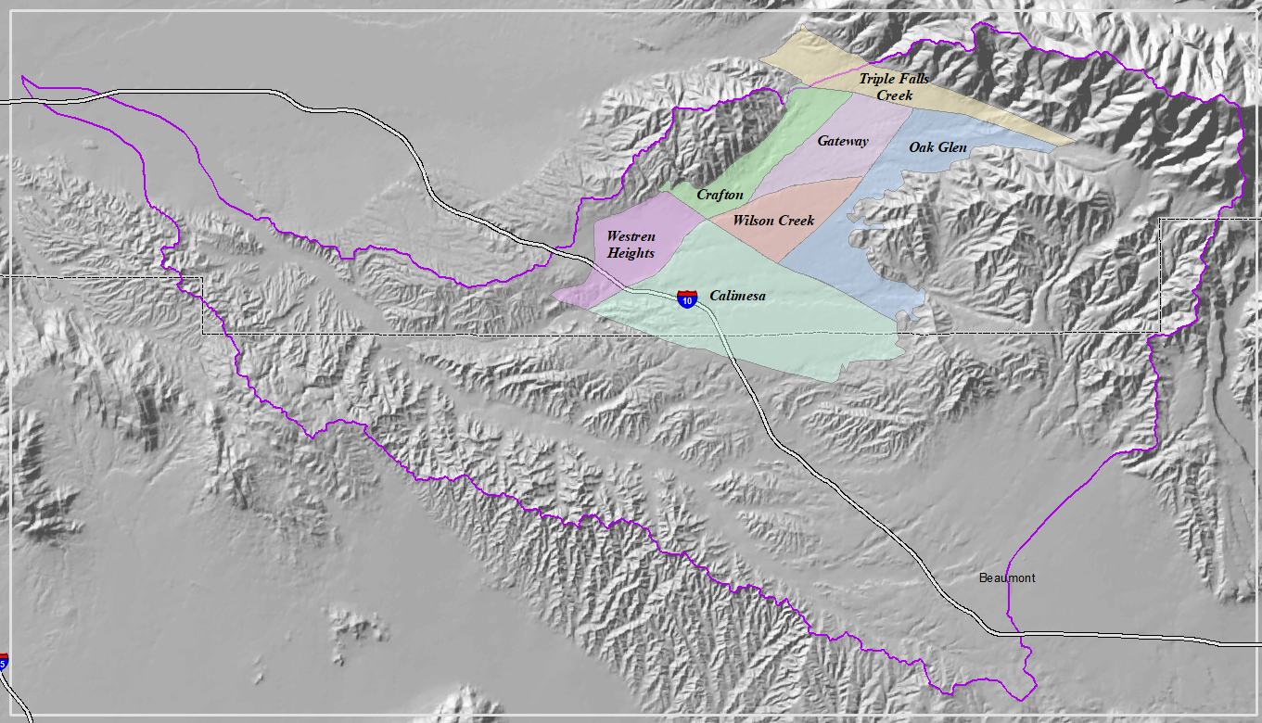
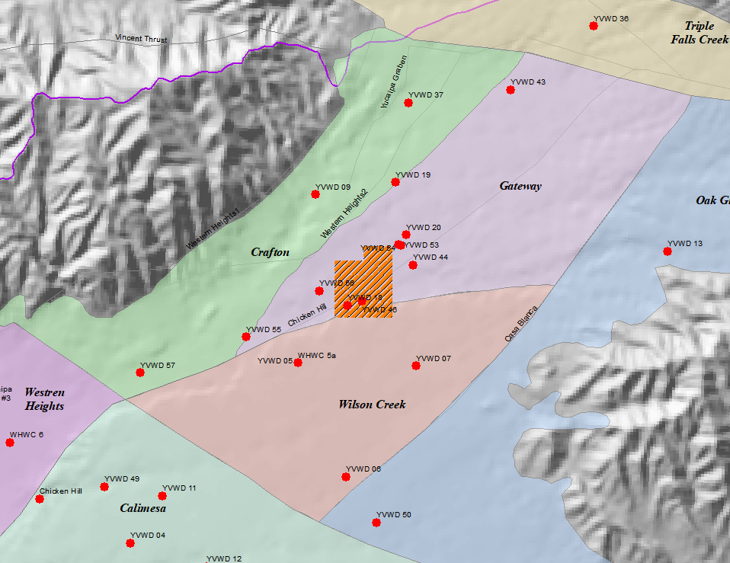
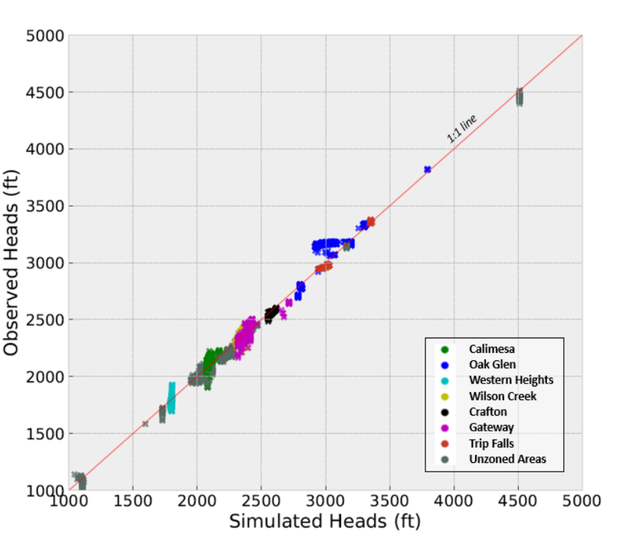
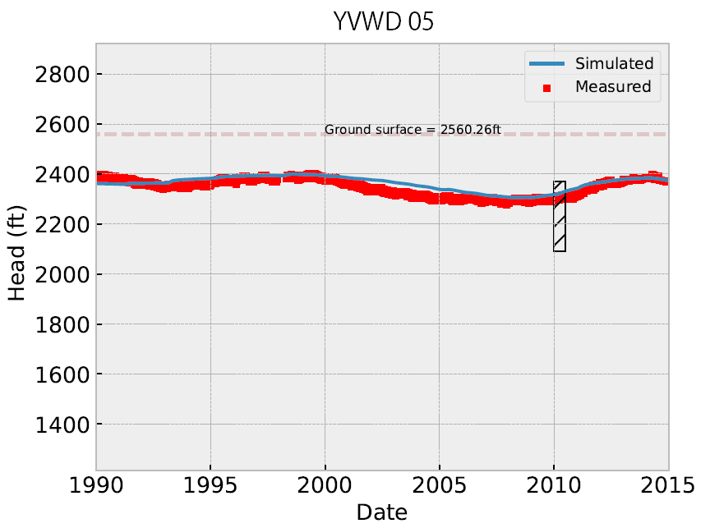
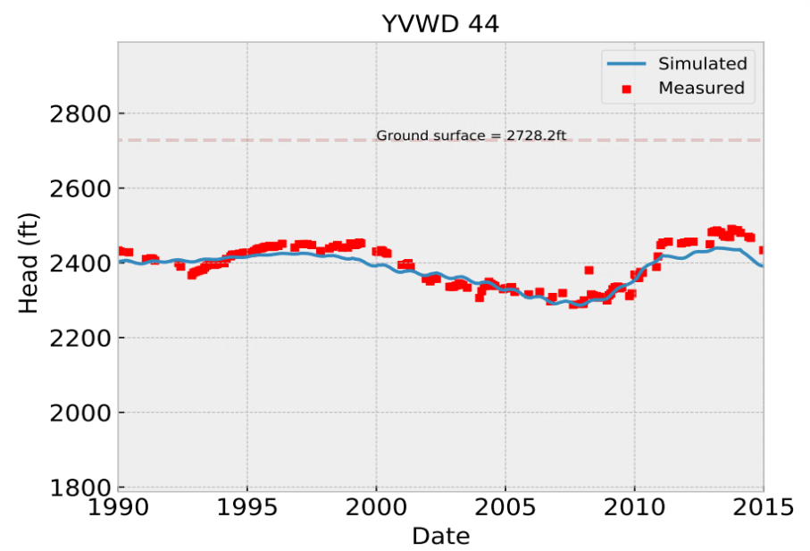
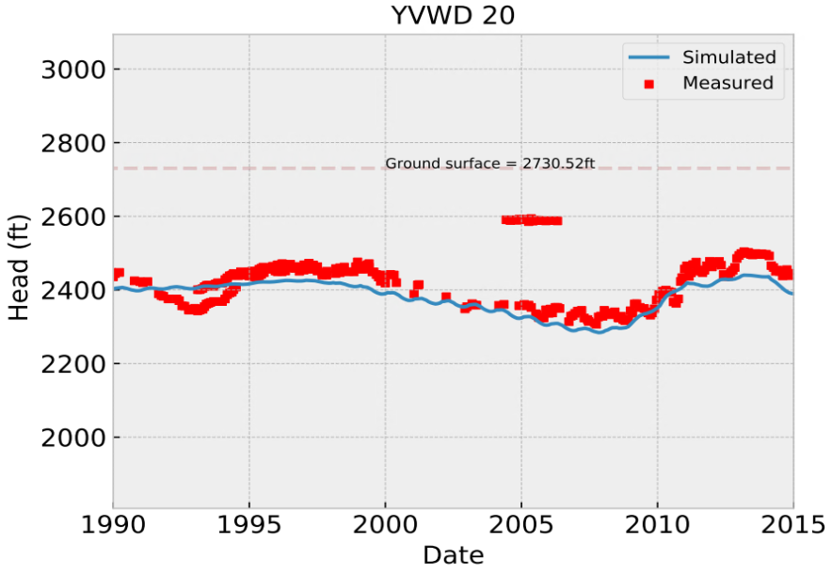
Uncertainty in Models & Data
Data Assimilation Yucaipa Integrated Hydrologic Model
Use of Ensemble Smoother in Calibration
Model Fit Estimated Parameters
Calibration Results

Slide 17
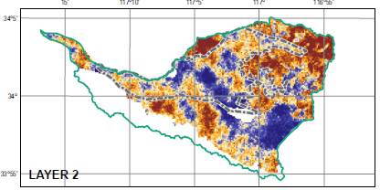
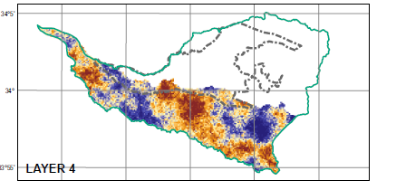
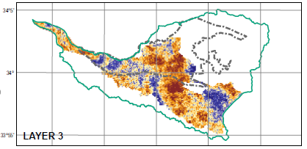
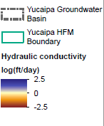
Uncertainty in Models & Data
Data Assimilation Yucaipa Integrated Hydrologic Model
Use of Ensemble Smoother in Calibration
Model Fit Estimated Parameters
Calibrated Hydraulic Conductivity Field

Slide 18
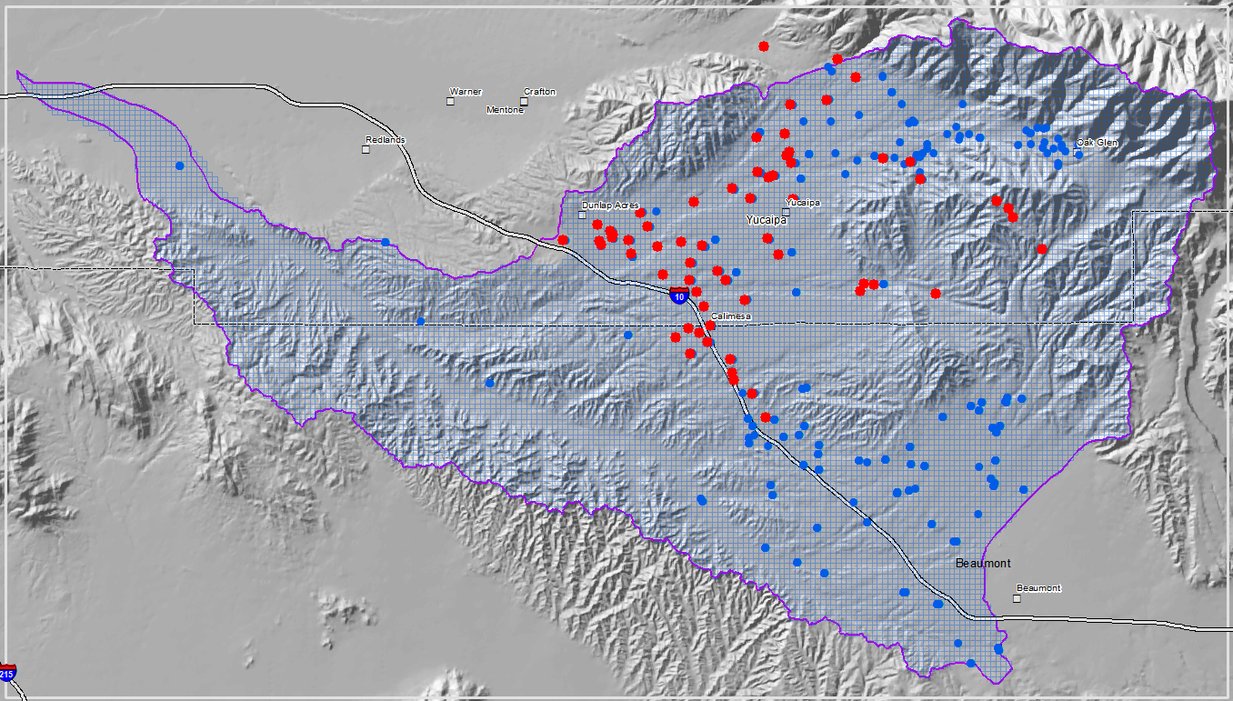
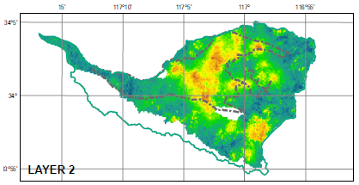
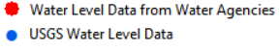
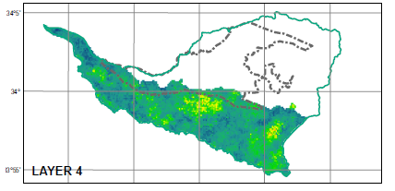
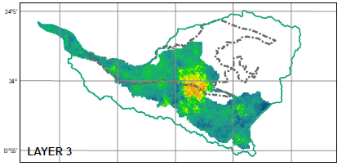
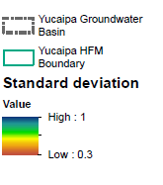
Uncertainty in Models & Data
Data Assimilation Yucaipa Integrated Hydrologic Model
Use of Ensemble Smoother in Calibration
Model Fit Estimated Parameters
Estimation Uncertainty

Slide 19
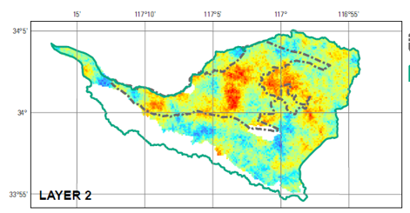
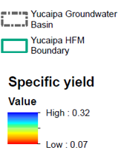
Uncertainty in Models & Data
Data Assimilation Yucaipa Integrated Hydrologic Model
Use of Ensemble Smoother in Calibration
Model Fit Estimated Parameters
Calibrated Specific Yield Field

Slide 20
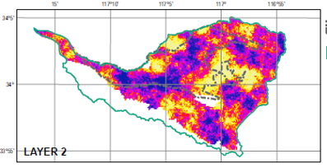
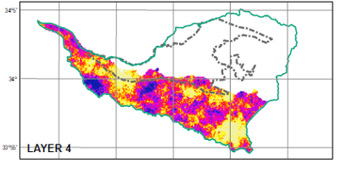
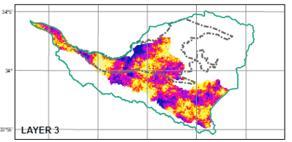
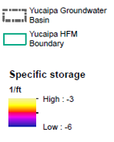
Uncertainty in Models & Data
Data Assimilation Yucaipa Integrated Hydrologic Model
Use of Ensemble Smoother in Calibration
Model Fit Estimated Parameters
Calibrated Specific Storage Field

Slide 21
Uncertainty in Models & Data
Data Assimilation Yucaipa Integrated Hydrologic Model
Use of Ensemble Smoother in Calibration
Model Fit Estimated Parameters
Other calibrated parameters…
UZF Parameters
Streambed Conductivity
Name | Value | Prior STD | Posterior STD
ET Extinction Depth (ft) | 5.74 | 0.7 | 0.61
Surface hydraulic Conductivity (ft/day) | -2.72 | 1.00 | 0.85
Vertical Conductivity (ft/day) | variable | 1.00 | 0.73 - 0.9
Segment Group ID | Conductivity ft/day) | Prior STD | Posterior STD
1 | 18.690 | 10.00 | 5.74
2 | 0.010 | 10.00 | 5.24
3 | 0.173 | 10.00 | 6.80
4 | 0.970 | 10.00 | 7.34
5 | 0.046 | 10.00 | 7.38
6 | 16.166 | 10.00 | 6.60
7 | 7.638 | 10.00 | 7.70
8 | 7.358 | 10.00 | 6.73
9 | 8.023 | 10.00 | 7.55
10 | 22.038 | 10.00 | 3.01
11 | 5.369 | 10.00 | 7.14
Barriers Conductance
ID | Name | Hydraulic Conductance log(1/day)¹ | Prior STD | Posterior STD
1 | Banning (Quaternary) | -4.34 | 1 | 0.90
2 | Banning (inactive) | 3.52 | 1 | 0.82
3 | Casa Blanca | 0.84 | 1 | 0.84
4 | Cherry Valley Thrust | Mean value² = -3.97 | 1 | 0.82
5 | Chicken Hill | Mean value² = -7.21 | 1 | 0.82
6 | Live Oak Canyon | 3.07 | 1 | 0.81
7 | San Andreas (Quaternary) | 3.22 | 1 | 0.89
8 | Western Heights1 | -0.42 | 1 | 0.91
9 | Western Heights2 | -2.33 | 1 | 0.79
10 | Yucaipa Graben | 0.01 | 1 | 0.86
Vertical Conductivity ratio
Layer No. | Kv/Kh ratio | Prior STD | Posterior STD
Layer 2 | 0.27 | 0.1 | 0.079
Layer 3 | 0.21 | 0.1 | 0.076
Layer 4 | 0.4 | 0.1 | 0.077

Slide 22
Uncertainty in Models & Data
Data Assimilation Yucaipa Integrated Hydrologic Model
Use of Ensemble Smoother in Calibration
Model Fit Estimated Parameters
Summery
Data assimilation (DA) combines data and model predictions within probabilistic framework to get the best estimate of unknown input parameters and model output.
Ensemble-based DA can be used to calibrate high-dimensional parameters (~10⁶ unknown parameters and their uncertainty).
Iterative Ensemble-based DA is an active area of research to benefit from the strengths of both Gradient-based methods and DA methods.

Slide 23
Uncertainty in Models & Data
Data Assimilation Yucaipa Integrated Hydrologic Model
Use of Ensemble Smoother in Calibration
Model Fit Estimated Parameters
Thank You!
Notes:
There are a lot more details about the methods that I am able to present in the given time, but interested people may refer to our paper that was pumblish earlier this year.

Slide 24
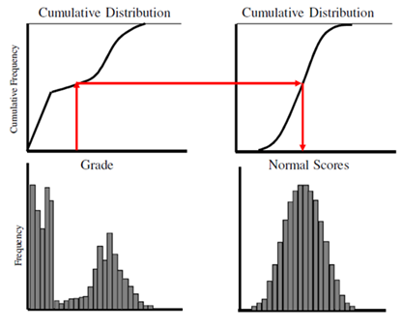
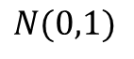
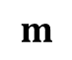

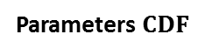
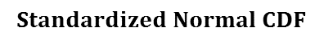
Uncertainty Sources
Data Assimilation Forward & Inverse Modeling
Origin of Kalman Filter Advantages of Kalman Filter Case Study
Introduction – Relax Non-gaussianity
Normal Score Transformation
Parameters $CDF$
$$Standardized Normal CDF$$
Parameter, prediction, and measurement values are replaced with values from standardized normal distribution with equal probabilities.
Transformed values are updated in KF.
Update results are back transformed to actual values space.
$$N(0,1)$$
$$m$$
$$m^{′}$$

